Slide 1
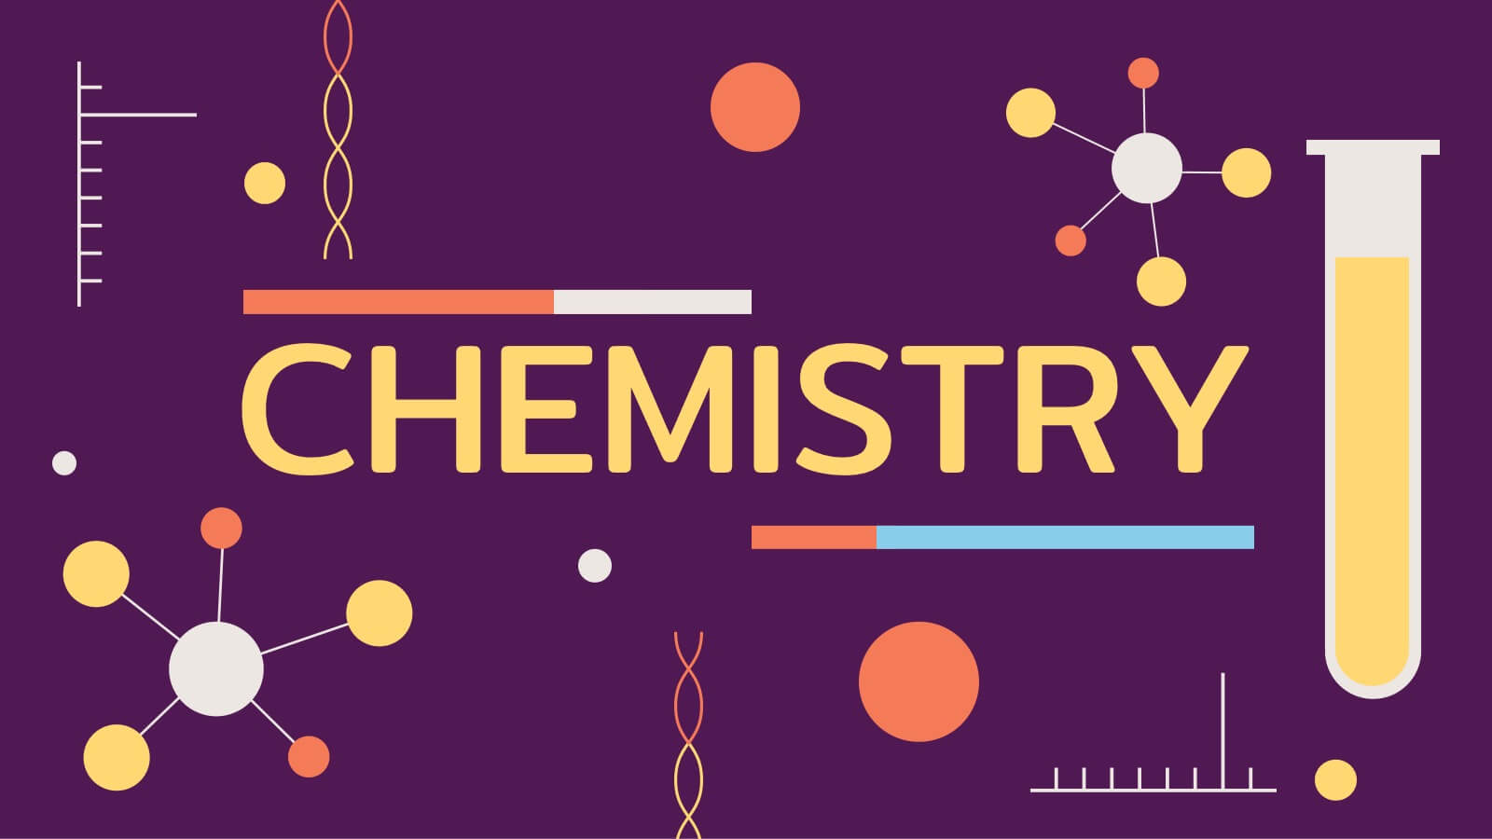

Slide 2
What is Chemistry?
Chemistry is a subdiscipline of science that deals with the study of matter and the substances that constitute it. It also deals with the properties of these substances and the reactions undergone by them to form new substances.
Chemistry primarily focuses on atoms, ions, and molecules which, in turn, make up elements and compounds.

Slide 3
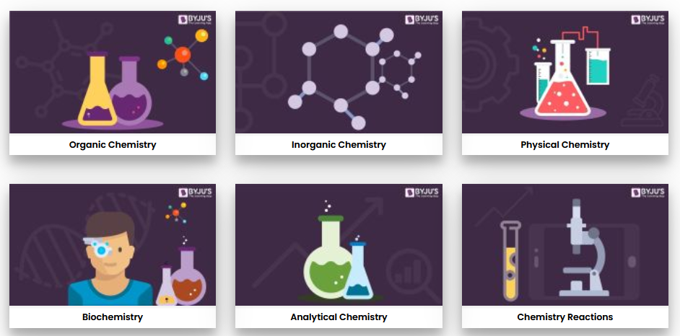
Branches of Chemistry

Slide 4
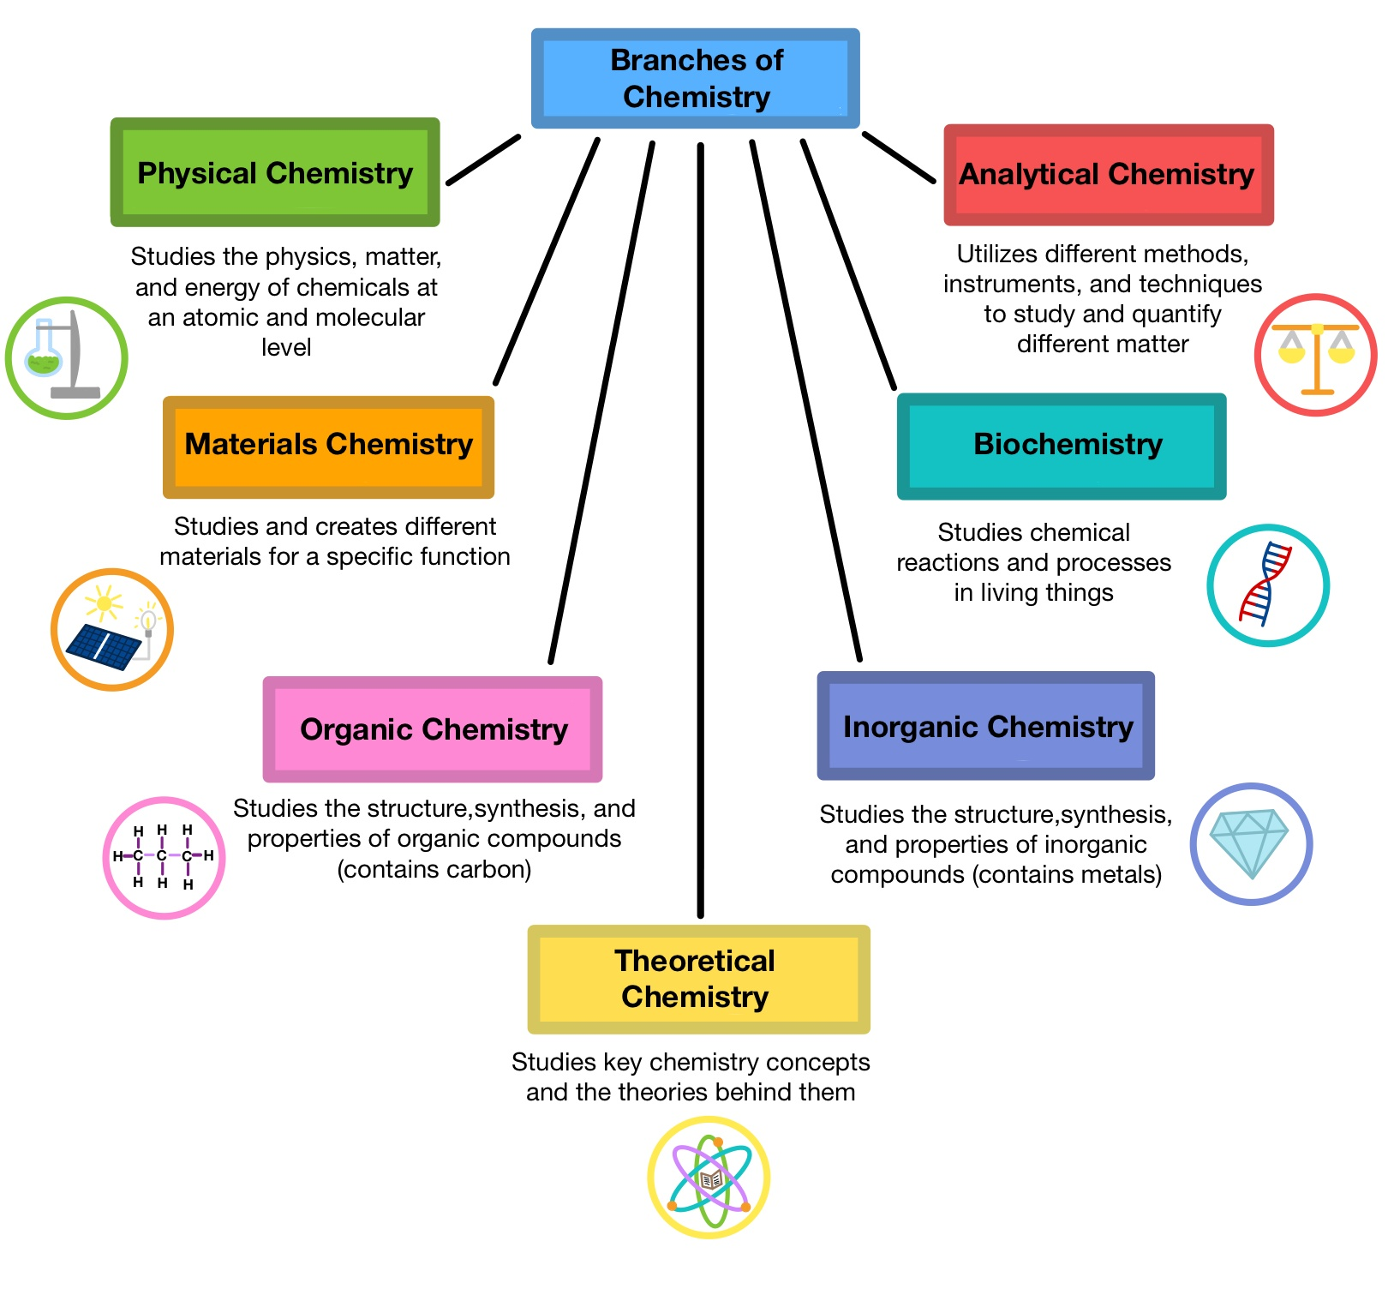

Slide 5
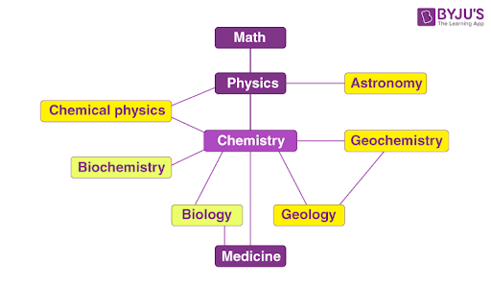
Relationship Between Chemistry and Other Branches of Science

Slide 6
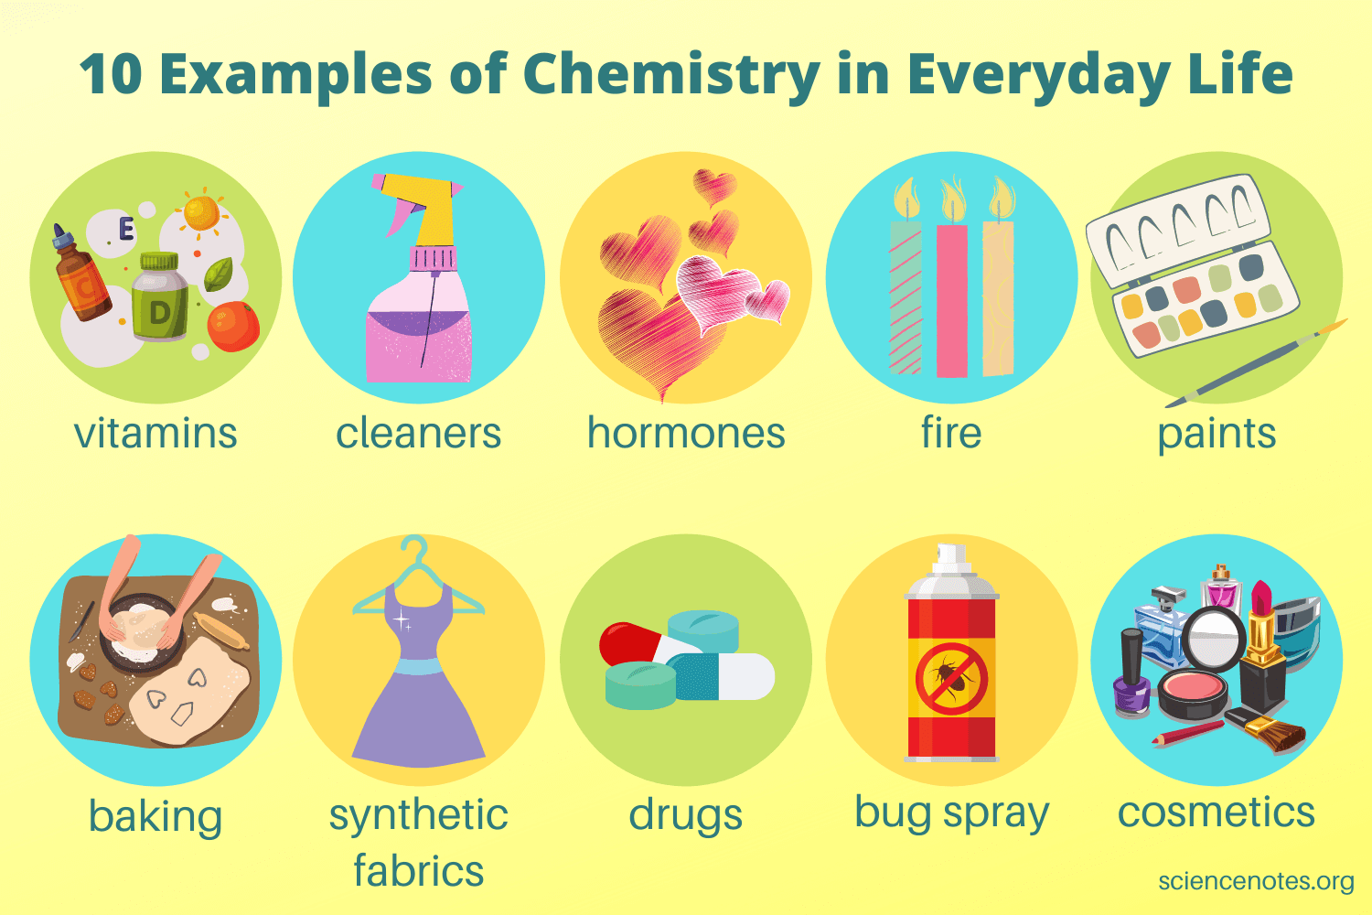
Examples of Chemistry in Our Daily Lives

Slide 7
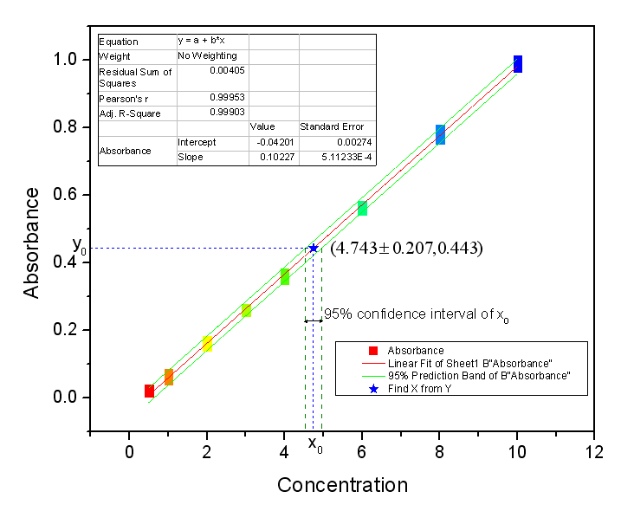
Origin: Graphing and Analysis for Chemistry

Slide 8
The End

